Slide 1


MOOD ANALYZER

Slide 2

CSE 202 – Object oriented programming with c++ – project
Project submitted to:
SRM University-AP, Andhra Pradesh
Bachelor of Technology
In
Computer Science Engineering Submitted to: Mr. Repaka Subha Sandeep Ms. Karnena Kavitha Rani

Slide 3
INTRODUCTION
Problem Statement: Develop a C++ program for a mental health and well-being project that interacts with users to collect information about their mood, gender, age, and provides supportive messages based on their mood. The program maintains a user response database and offers additional resources such as helpline numbers and stress relief game suggestions. The project aims to create a supportive and empathetic environment, promoting mental health awareness and providing users with tools to manage their well-being. Aim of the Project: The primary objective of the project is to: – Gather user information, including name, gender, age, and mood.
– Validate user inputs to ensure accuracy and handle unexpected inputs gracefully.
– Display a mood scale to help users quantify their emotional state.
– Write user responses to a file ("user_responses.txt") for future reference.
– Assess user mood levels and provide personalized responses and suggestions.

Slide 4
CONCEPTS USED IN THE project
1. Input/Output Operations:
– Uses cin and getline for user input.
– Displays messages and information to the user through cout.
2. Classes:
– Defines a class “User” with private data members for the user’s name, gender, age and mood.
3. Constructors:
– Initializes age and mood to default values.
4. File Handling:
– Involves file operations using ofstream to write user responses to a file.
5. Data Encapsulation:
– Employing private member variables within the User class, restricting direct access and ensuring controlled manipulation of user data.
6. Conditional Statements:
– Utilizes if, else if, and else statements for decision-making based on user mood.

Slide 5
7. Loops:
– Implements while loops to ensure valid input for age and mood.
8. Functions:
– Defines functions like getUserInfo and writeToFile for modular code organization and reuse.
9. Data Types:
– Utilizes string for handling textual input (user name, gender).
– Uses int and double for age and mood, respectively.
10. Error Handling:
– Implements error handling for invalid inputs using cin.clear() and cin.ignore().
11. Resource Integration:
– Embeds external resources (helpline numbers, stress relief game links) directly into the code.
12. String Concatenation:
– Concatenates strings for constructing messages, including user details and responses.
13. User Interaction and Engagement:
– Incorporates prompts and questions to engage the user throughout the program.

Slide 6
ALGORITHM
1. Define a User class.
a. The class User is defined with private data members for the user's name, gender, age, and mood.
b. The constructor initializes age and mood to default values.
2. Define function getUserInfo:
a. Prompt the user for their name and store it in the variable userName.
b. Greet the user using their name.
c. Use a loop to:
- Prompt the user for their gender and store it in the variable gender.
- Convert the gender input to lowercase for case-insensitive validation.
- Check if the input is valid (either "male," "female," or "other"). If not, repeat
the loop.
d. Use a loop to:
- Prompt the user for their age and store it in the variable age.
- Validate the age input (between 10 and 100). If not valid, repeat the loop.
e. Use a loop to:
- Prompt the user to rate their mood on a scale of 0.5 to 5.0 and store it in the
variable mood.
- Validate the mood input. If not valid, repeat the loop.

Slide 7
2. Define Function writeToFile:
a. Open a file named user_responses.txt for appending (ios::app).
- If the file is open:
Write the user's information (name, gender, age, mood) to the file.
Close the file.
- If the file cannot be opened:
Output an error message.
3. Main Function:
a. An instance of the User class is created.
b. Declare variables: userName, gender, age, and mood.
c. Call getUserInfo with references to these variables to collect user information.
d. Call writeToFile with the collected user information to store it in a file.

Slide 8
4. Evaluate User's Mood:
a. Check the value of mood:
- If mood >= 3.5, print a positive message and offer stress relief games.
- If mood >= 3.0, print a positive message and offer stress relief games.
- If mood >= 1.5, acknowledge challenges, offer support, and optionally provide
helpline information.
- If mood >= 0.5, acknowledge low mood, offer support, and optionally provide
helpline information.
5. Stress Relief Games:
If the user chooses to play stress relief games, provide links to two websites.
6. Closing Message:
Provide a closing message encouraging self-care and well-being.

Slide 9
SOURCE CODE
#include <iostream>
#include <fstream>
#include <string>
#include <limits>
using namespace std;
class User
{
private:
string userName;
string gender;
int age;
double mood;
public:
User() : age(0), mood(0.0) {}
void getUserInfo()
{
cout << "What is your name?\n";
getline(cin, userName);
cout << "\nHello, " << userName << "!\n";

Slide 10
while (true)
{
cout << "What is your gender? (Male/Female/Other)\n";
getline(cin, gender);
for (char& c : gender)
{
c = tolower(c);
}
while (true)
{
cout << "What is your gender? (Male/Female/Other)\n";
getline(cin, gender);
for (char& c : gender)
{
c = tolower(c);
}

Slide 11
if (gender == "male" || gender == "female" || gender == "other")
{
break;
}
else
{
cout << "Invalid gender input. Please enter a valid gender
(Male/Female/Other).\n";
}
}
while (true)
{
cout << "\nHow old are you?\n";
if (cin >> age && age > 10 && age < 100)
{
break;
}
else
{
cout << "Invalid input. Please enter a valid age.\n";
cin.clear();
cin.ignore(numeric_limits<streamsize>::max(), '\n’);
}
}

Slide 12
while (true)
{
cout << "\nOn a scale of 0.5 to 5, how are you feeling, " << userName << "?\n(A mood scale is provided below for your reference.)\n“;
cout << "Mood Scale:\n";
cout << "0.5: Extremely Unhappy\n";
cout << "1.0: Very Sad\n";
cout << "1.5: Unhappy\n";
cout << "2.0: Somewhat Down\n";
cout << "2.5: Neutral\n";
cout << "3.0: Content\n";
cout << "3.5: Happy\n";
cout << "4.0: Very Happy\n";
cout << "4.5: Delighted\n";
cout<< "5.0: Ecstatic\n";
if (cin >> mood && mood >= 0.5 && mood <= 5.0)
{
break;
}
else
{
cout << "Invalid input. Please enter a valid mood score.\n";
cin.clear();
cin.ignore(numeric_limits<streamsize>::max(), '\n’);
}
}
}

Slide 13
void writeToFile(const string& userName, const string& gender, int age, double mood)
{
ofstream responseFile("user_responses.txt", ios::app);
if (responseFile.is_open())
{
responseFile << "User: " << userName << ", Gender: " << gender << ", Age: " << age << ", Mood: " << mood << "\n";
responseFile.close();
}
else
{
cerr << "Unable to open the response file for writing.\n";
}
}
double getMood() const
{
return mood;
}
const string& getUserName() const
{
return userName;
}
};
int main()
{
User user;
user.getUserInfo();
user.writeToFile();
double mood = user.getMood();
const string& username = user.getUserName();

Slide 14
if (mood >= 3.5)
{
cout << "\nThat's wonderful! We're genuinely happy for you and wish you continued joy and success in every aspect of your life.
Always remember that you are enough. You are loved.\n";
char gresponse;
cout << "Would you like to play some stress relief games?(y/n)\n";
cin >> gresponse;
if(gresponse == 'y' || gresponse == 'Y’)
{
cout << "1. [Silver Games - Stress Relief Games] - A website which provides you with stress relief games(You can copy and paste
the link):\n";
cout << "https://www.silvergames.com/en/t/stress-relief\n";
cout << "2. [A Soft Murmur - Create Your Own Ambient Soundscape] - A website which lets you create your own soundscape and
gives you a calming effect(You can copy and paste the link):\n";
cout << "https://asoftmurmur.com/\n";
}
else
{
cout << "Cool! We hope you always remember to enjoy the little joys of life and embrace your inner child.";
}
}

Slide 15
else if (mood >= 3.0)
{
cout << "\nBeing content is a beautiful state of mind. We hope this feeling persists and that you find utmost happiness in your life’s
journey. Always remember that you are enough. You are loved.\n";
char gresponse;
cout << "Would you like to play some stress relief games?(y/n)\n";
cin >> gresponse;
if(gresponse == 'y' || gresponse == 'Y’)
{
cout << "1. [Silver Games - Stress Relief Games] - A website which provides you with stress relief games(You can copy and paste
the link):\n";
cout << "https://www.silvergames.com/en/t/stress-relief\n";
cout << "2. [A Soft Murmur - Create Your Own Ambient Soundscape] - A website which lets you create your own soundscape and
gives you a calming effect(You can copy and paste the link):\n";
cout << "https://asoftmurmur.com/\n";
}
else
{
cout << "Cool! We hope you always remember to enjoy the little joys of life and embrace your inner child.";
}
}

Slide 16
else if (mood >= 1.5)
{
cout << "\nWe understand that things might be tough. ";
char response;
cout << "Have you been feeling this way consistently over a period of time? (y/n)\n";
cin >> response;
if (response == 'y' || response == 'Y’)
{
cout << "We want you to know that your feelings are valid. It's completely okay to feel this way. If this feeling persists over a
prolonged period of time, consider reaching out to mental health professionals for support.\n";
char response;
cout << "Would you like information on helpline numbers? (y/n)";
cin >> response;
if(response == 'y' || response == 'Y’)
{
cout << "For your reference, here are a few helplines that may provide assistance.\n1. Vandrevala Foundation Helpline: 1-860-
266-2345\n2. Roshni Helpline: 040-66202000\n3. Snehi Helpline: 91-22-27719595 / 91-22-27719596\n4. iCall Helpline:
9152987821 / 9152987823\n5. Sumaitri Helpline: 011-23389090\n6. VIMHANS (Vidyasagar Institute of Mental Health and
Neurosciences) Helpline: 011-66206620\n7. Parivarthan Counseling Helpline (Bangalore) Helpline: 7676602602\n8.
COOJ Mental Health Foundation (Goa) Helpline: 0832-2252525\n9. Samaritans Mumbai Helpline: 91-8422984528 / 91-
8422984529 / 91-8422984530\n";
}

Slide 17
else
{
cout << "It's completely okay if you're not ready for helpline numbers right now. Remember, seeking help is a personal
journey, and when you're ready, support will be available. Don't lose hope; everything will be fine. Take your time and
reach out when you feel comfortable.\n";
}
}
else
{
cout << "If this feeling is related to a specific incident, remember that setbacks happen to everyone. Always remember that you
are enough. You are loved. Stay positive and focus on the things that bring you joy.\n";
}
char gresponse;
cout << "Would you like some stress relief games as a way to take your mind off things?(y/n)\n";
cin >> gresponse;
if(gresponse == 'y' || gresponse == 'Y’)
{
cout << "1. [Silver Games - Stress Relief Games] - A website which provides you with stress relief games(You can copy and paste
the link):\n";
cout << "https://www.silvergames.com/en/t/stress-relief\n";
cout << "2. [A Soft Murmur - Create Your Own Ambient Soundscape] - A website which lets you create your own soundscape and
gives you a calming effect(You can copy and paste the link):\n";
cout << "https://asoftmurmur.com/\n";
}

Slide 18
else
{
cout << "Cool! We hope you always remember to enjoy the little joys of life and embrace your inner child.";
}
}
else if (mood >= 0.5)
{
cout << "It's okay to feel this way. We're here for you. ";
char response;
cout << "Have you been feeling this way consistently over a period of time? (y/n)\n";
cin >> response;
if (response == 'y' || response == 'Y’)
{
cout << "If you've been feeling consistently low over a period of time, it might be more serious than you think. Consider reaching
out to mental health professionals for support. You are not alone.\n";
char response;
cout << "Would you like information on helpline numbers? (y/n)\n";
cin >> response;

Slide 19
if(response == 'y' || response == 'Y’)
{
cout << "For your reference, here are a few helplines that may provide assistance.\n1. Vandrevala Foundation Helpline: 1-860-
266-2345\n2. Roshni Helpline: 040-66202000\n3. Snehi Helpline: 91-22-27719595 / 91-22-27719596\n4. iCall Helpline:
9152987821 / 9152987823\n5. Sumaitri Helpline: 011-23389090\n6. VIMHANS (Vidyasagar Institute of Mental Health and
Neurosciences) Helpline: 011-66206620\n7. Parivarthan Counseling Helpline (Bangalore) Helpline: 7676602602\n8.
COOJ Mental Health Foundation (Goa) Helpline: 0832-2252525\n9. Samaritans Mumbai Helpline: 91-8422984528 / 91-
8422984529 / 91-8422984530\n";
}
else
{
cout << "It's completely okay if you're not ready for helpline numbers right now. Remember, seeking help is a personal
journey, and when you're ready, support will be available. Don't lose hope; everything will be fine. Take your time and
reach out when you feel comfortable.\n";
}
}
else
{
cout << "If this feeling is related to a specific incident, remember that it's okay to seek help. Consider talking to someone you
trust or reaching out to helplines. Always remember that you are enough. You are loved.\n";
char response;
cout << "If you need someone to talk to and vent, we can provide the information of some helpline numbers. Would you like for us
to provide you with it? (y/n)\n";
cin >> response;

Slide 20
if(response == 'y' || response == 'Y’)
{
cout << "For your reference, here are a few helplines that may provide assistance.\n1. Roshni Helpline: 040-66202000\n2.
iCall Helpline: 9152987821 / 9152987823\n3. Sumaitri Helpline: 011-23389090\n4. COOJ Mental Health Foundation (Goa)
Helpline: 0832-2252525\n5. Samaritans Mumbai Helpline: 91-8422984528 / 91-8422984529 / 91-8422984530\n";
}
else
{
cout << "It's completely okay if you're not ready for helpline numbers right now. Remember, seeking help is a personal
journey, and when you're ready, support will be available. Don't lose hope; everything will be fine. Take your time and
reach out when you feel comfortable.\n";
}
}
char gresponse;
cout << "Would you like some stress relief games as a way to take your mind off things?(y/n)\n";
cin >> gresponse;
if(gresponse == 'y' || gresponse == 'Y’)
{
cout << "1. [Silver Games - Stress Relief Games] - A website which provides you with stress relief games(You can copy and
paste the link):\n";
cout << "https://www.silvergames.com/en/t/stress-relief\n";
cout << "2. [A Soft Murmur - Create Your Own Ambient Soundscape] - A website which lets you create your own soundscape
and gives you a calming effect(You can copy and paste the link):\n";
cout << "https://asoftmurmur.com/\n";
}
else
{
cout << "Cool! We hope you always remember to enjoy the little joys of life and embrace your inner child.";
}
}
cout << "\nPlease always remember to love yourself first. Take good care of yourself. We wish you the best!";
return 0;
}

Slide 21
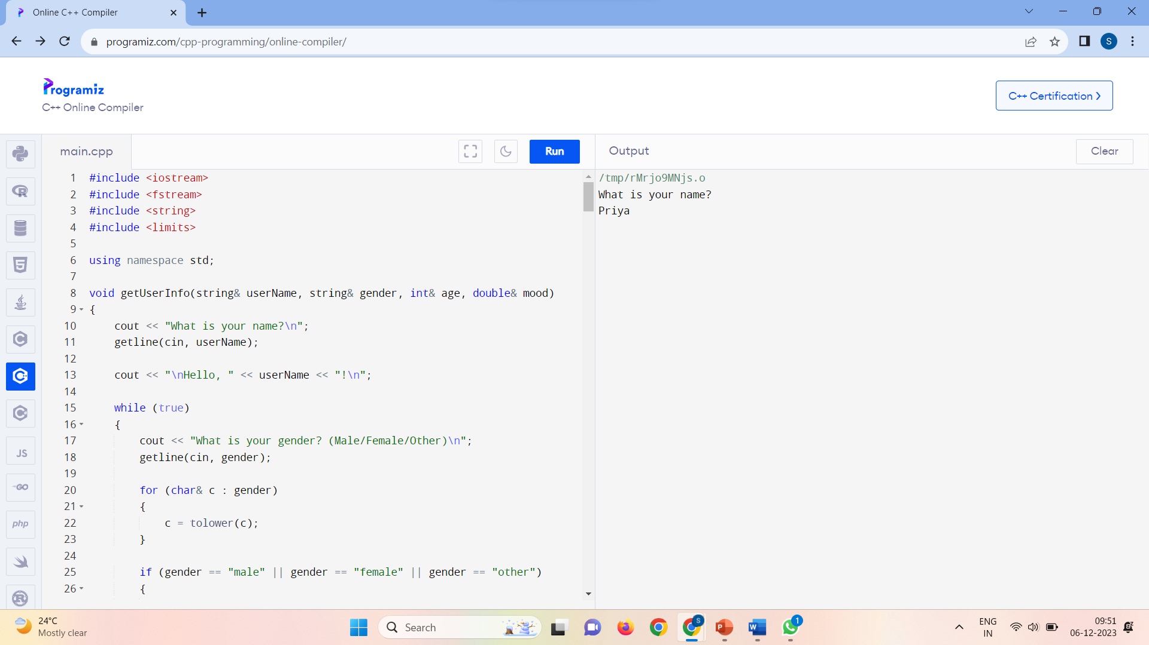
OUTPUT
Name Input:

Slide 22
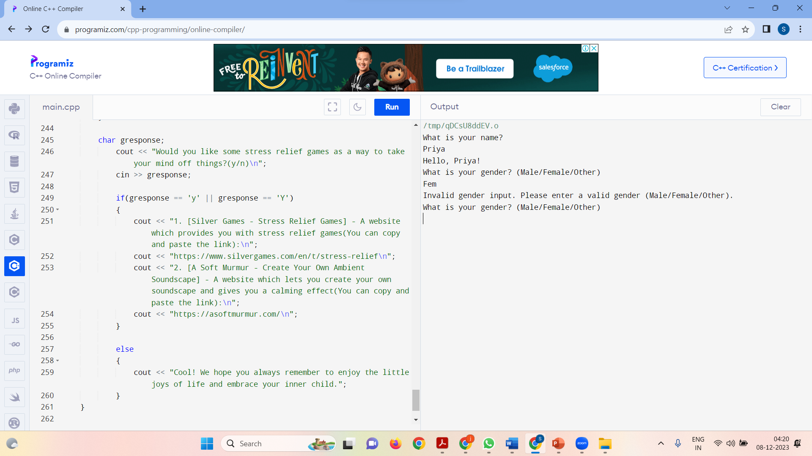
Invalid Gender Input:

Slide 23
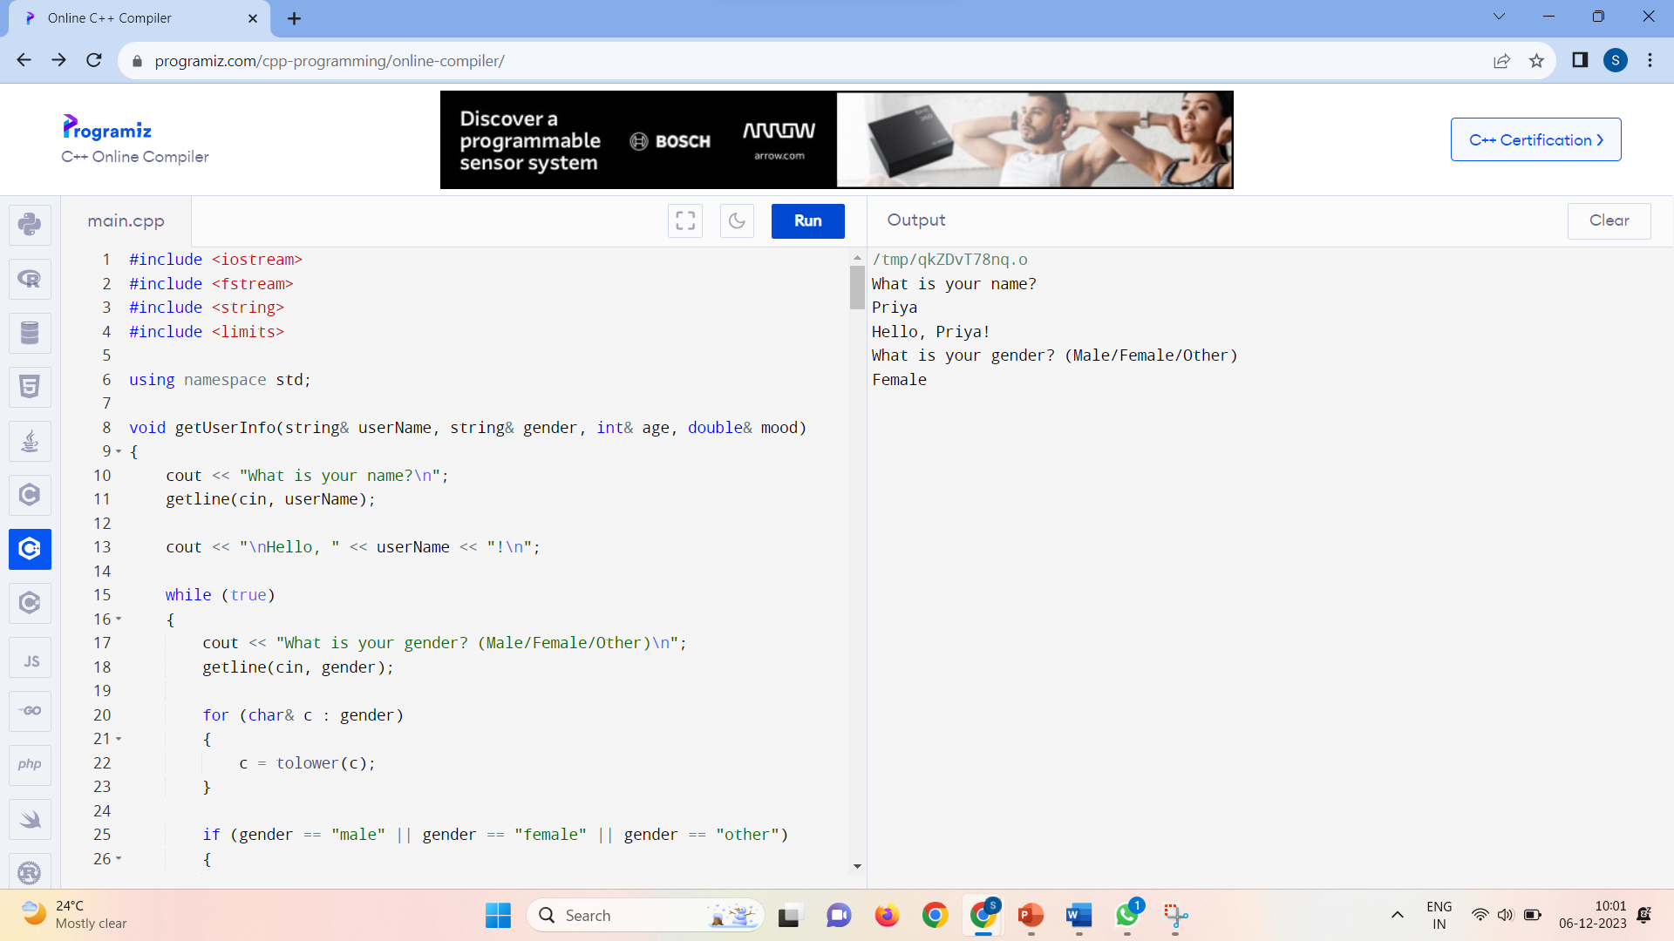
Valid Gender Input:

Slide 24
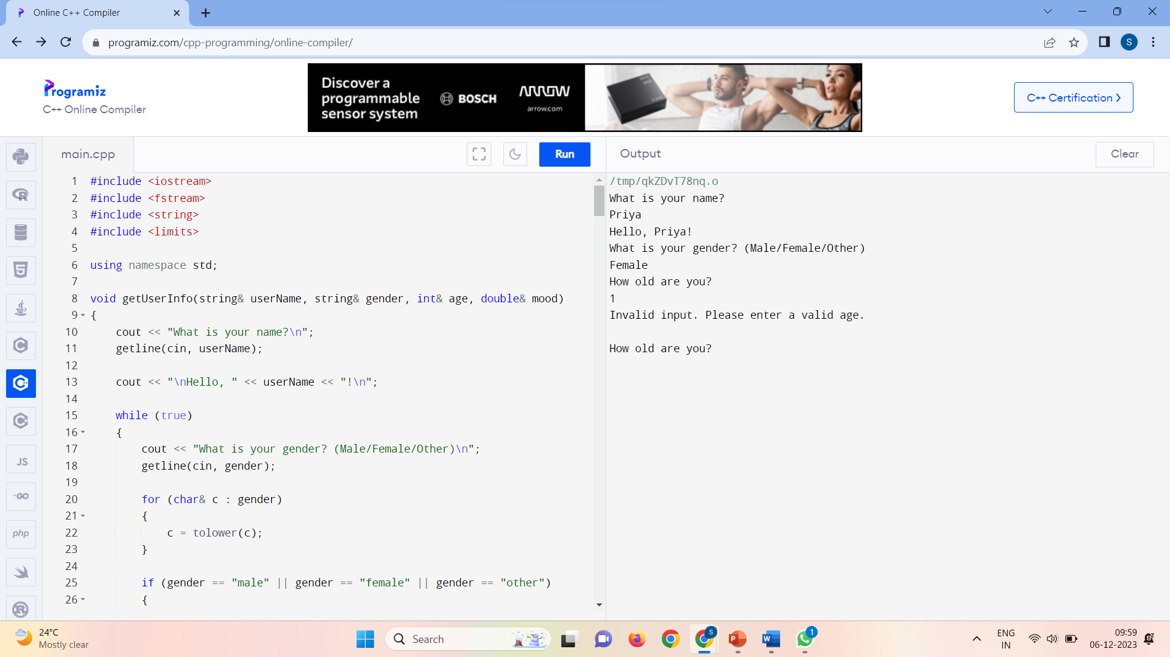
Invalid Age Input:

Slide 25
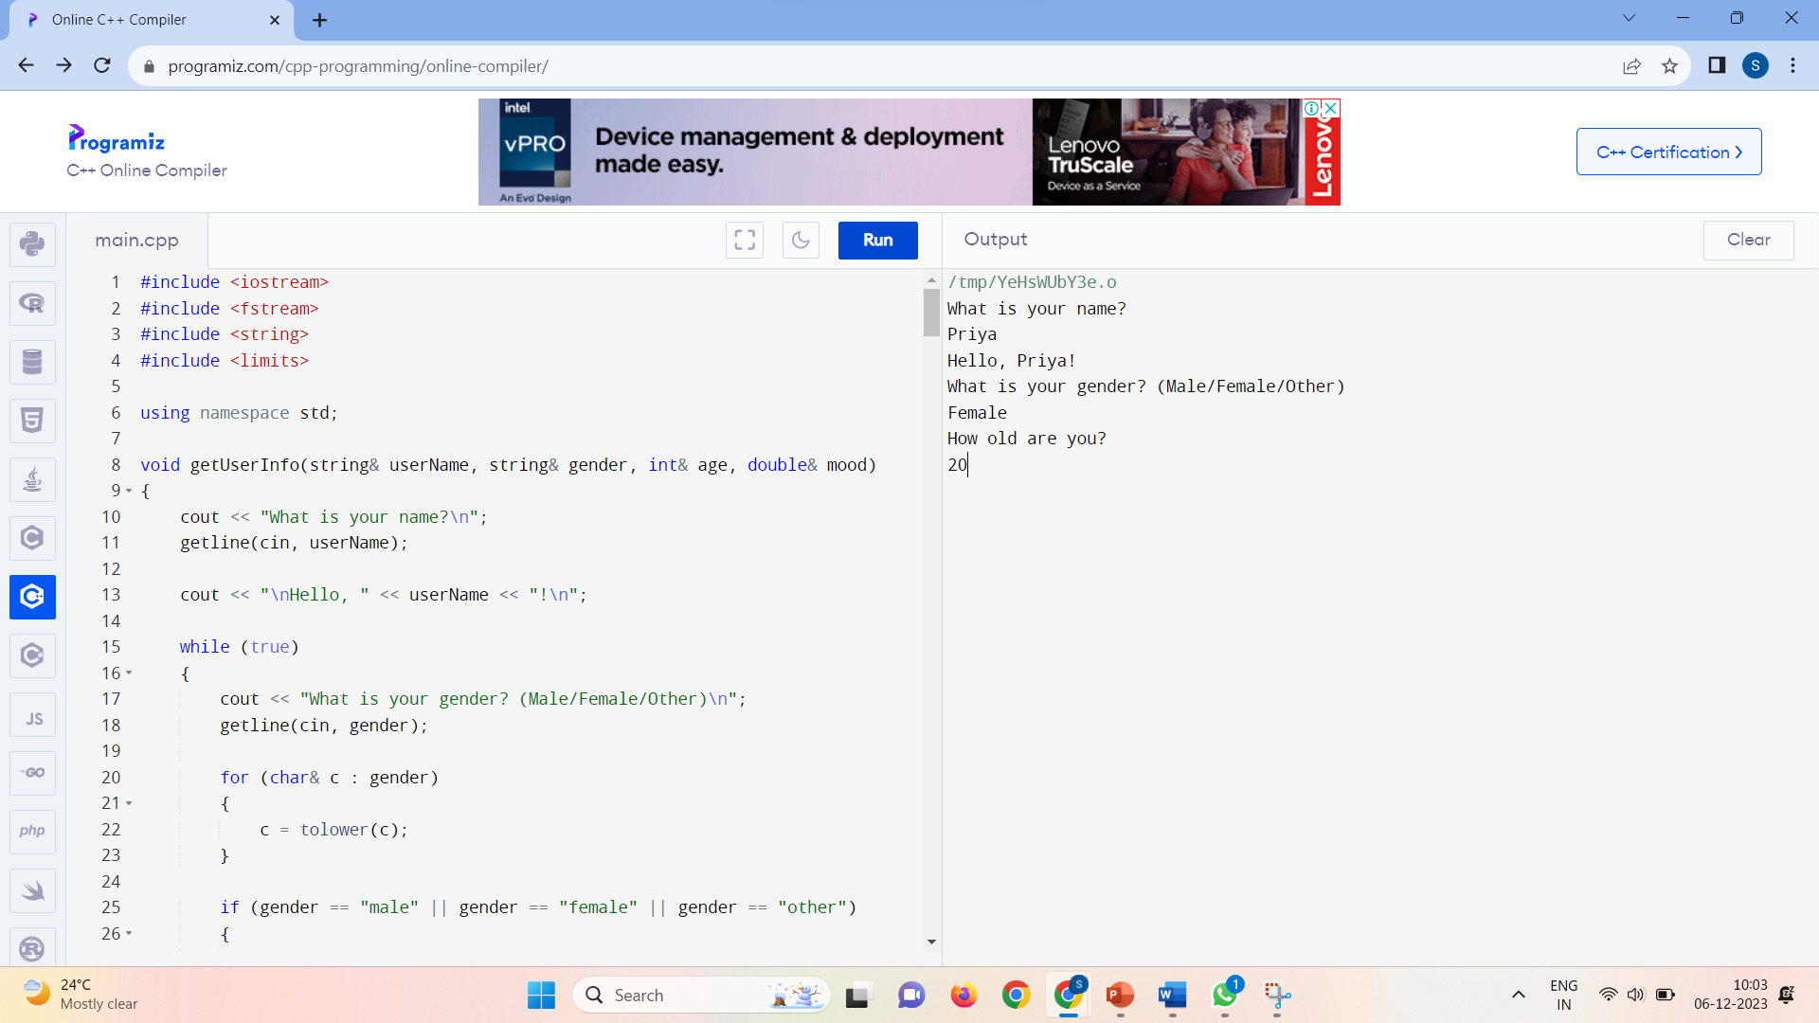
Valid Age Input:

Slide 26

If mood >= 0.5 and mood < 1.5:

Slide 27
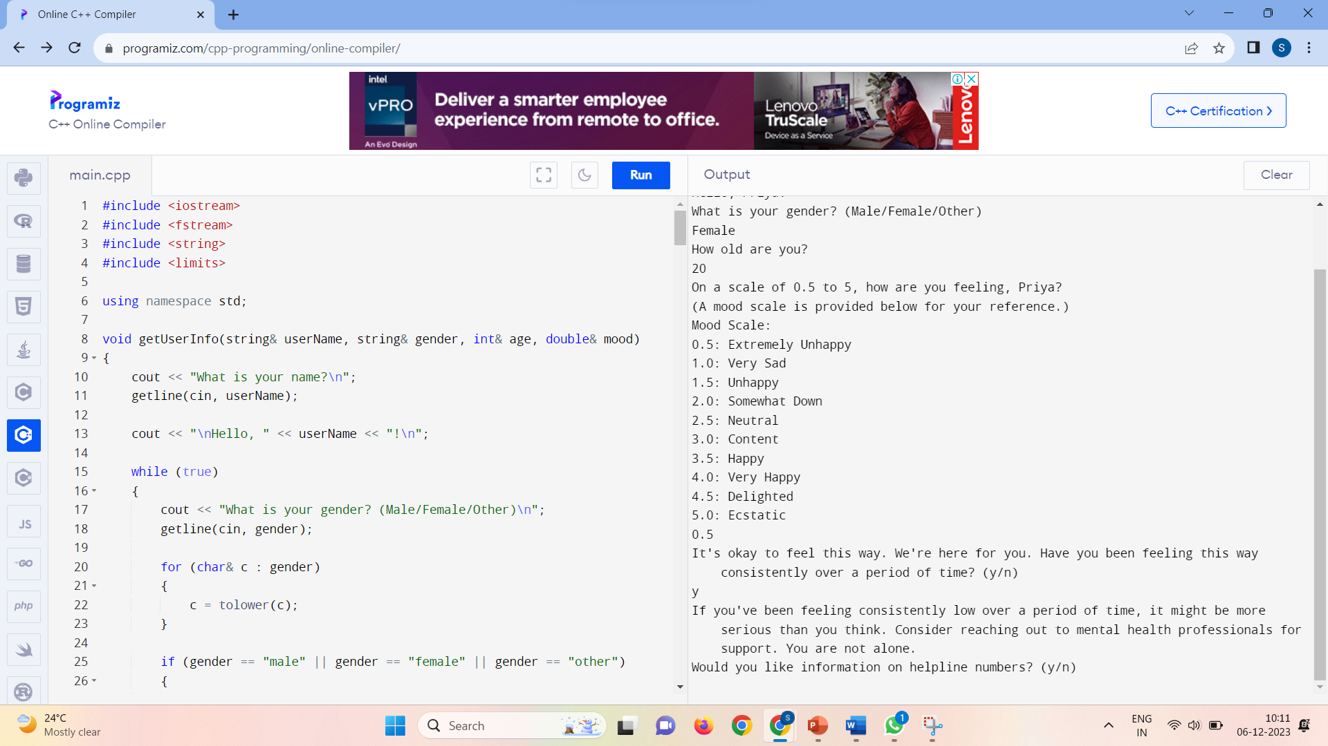
If the extremely bad mood is consistent:

Slide 28
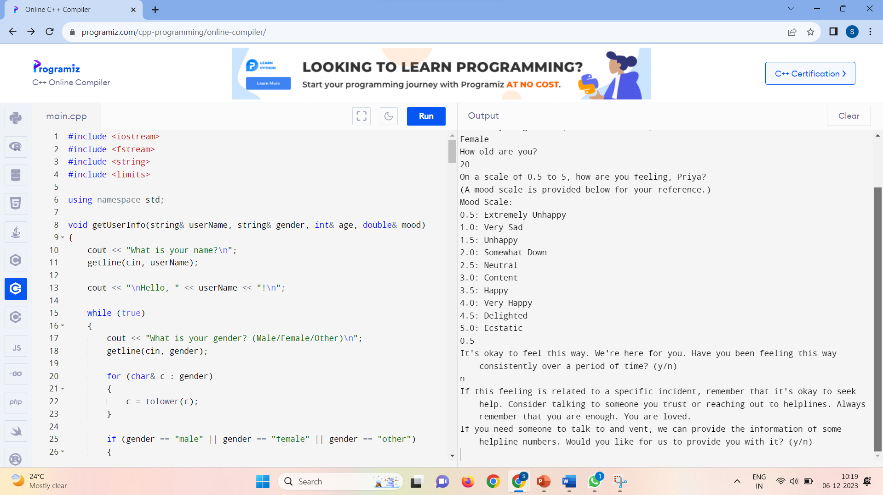
If the extremely bad mood is not consistent:

Slide 29
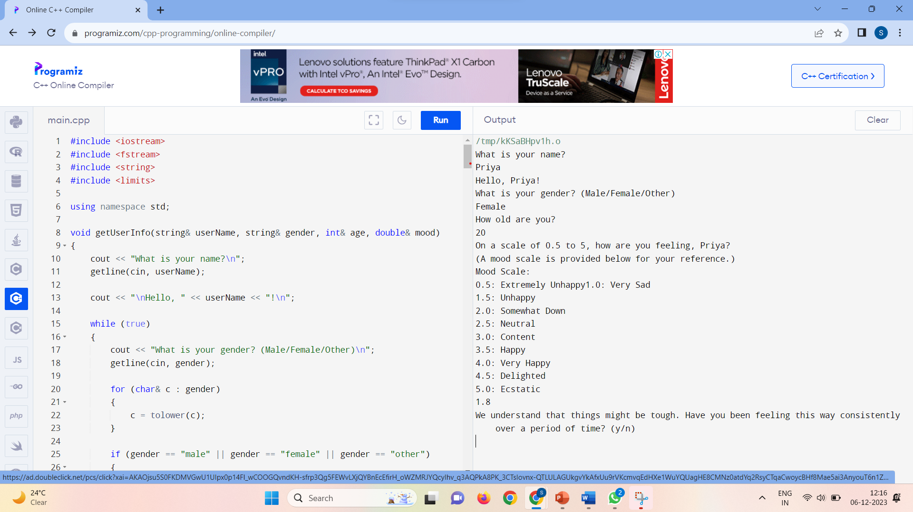
If mood >= 1.5 and mood < 3.0:

Slide 30
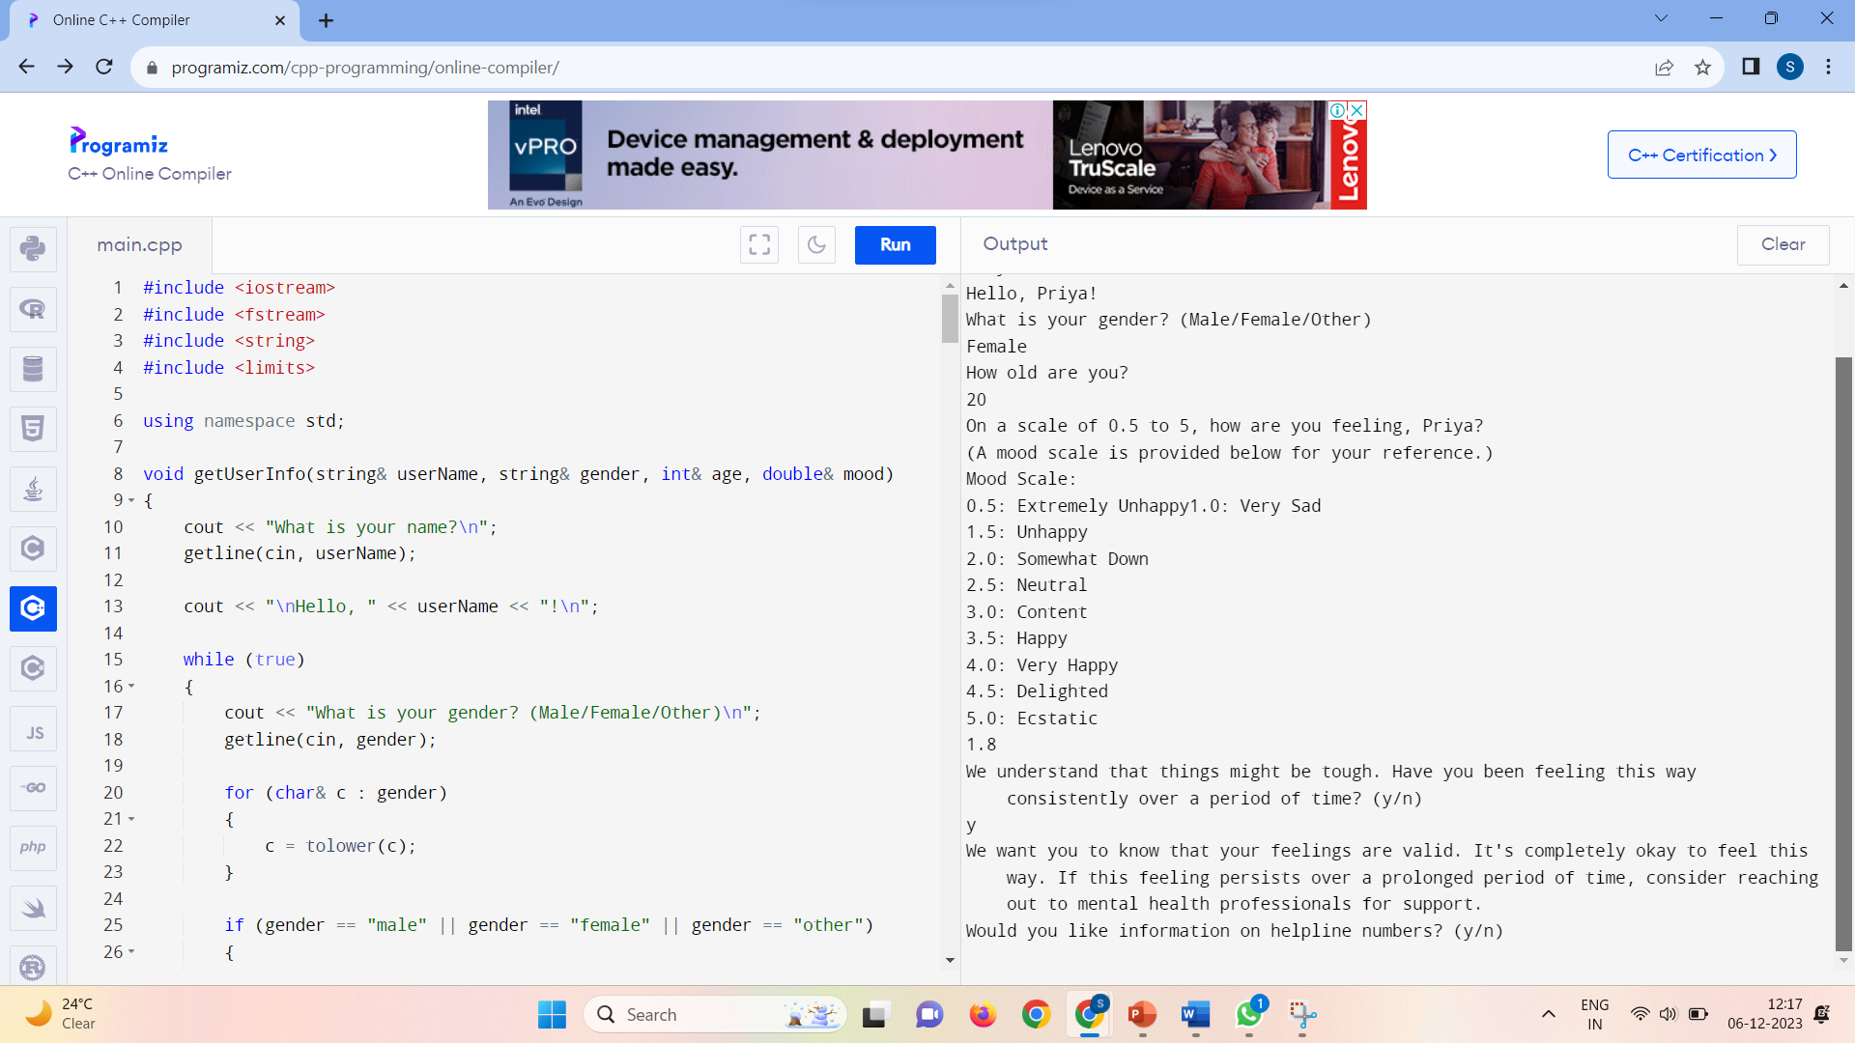
If the bad mood is consistent:

Slide 31
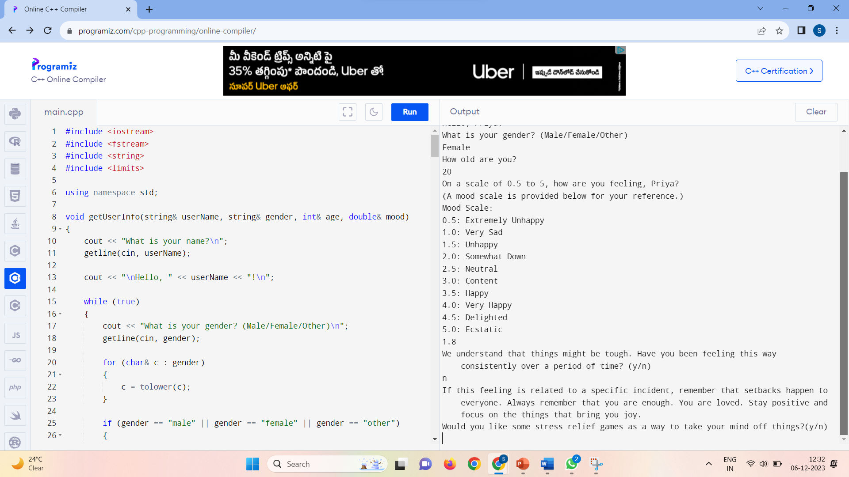
If the bad mood is not consistent:

Slide 32
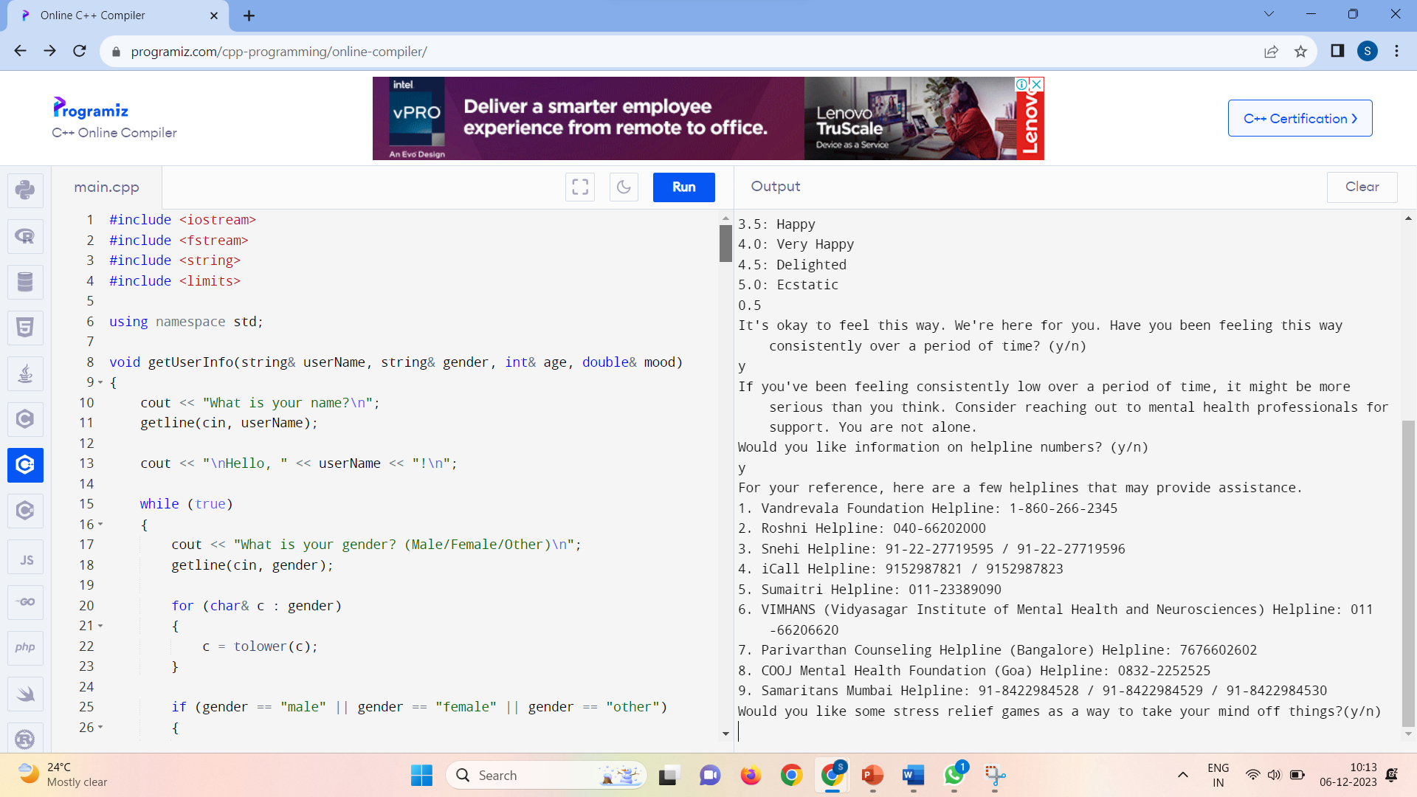
If user wants helpline numbers information(for consistent bad mood):

Slide 33
If user does not want helpline numbers information(for consistent bad mood):

Slide 34
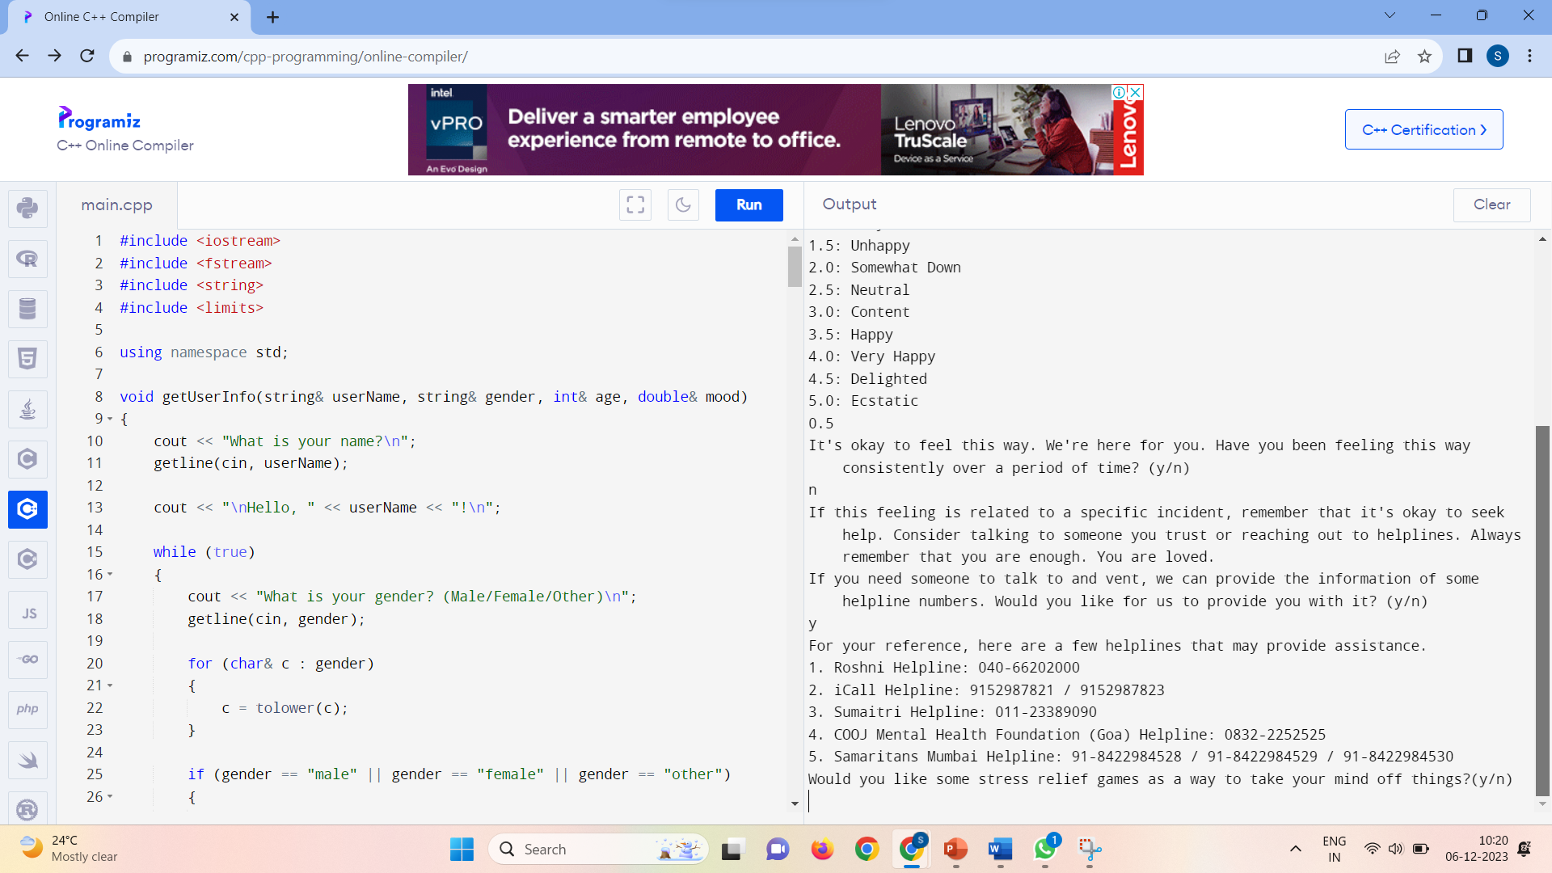
If user wants helpline numbers information(for non-consistent bad mood):

Slide 35
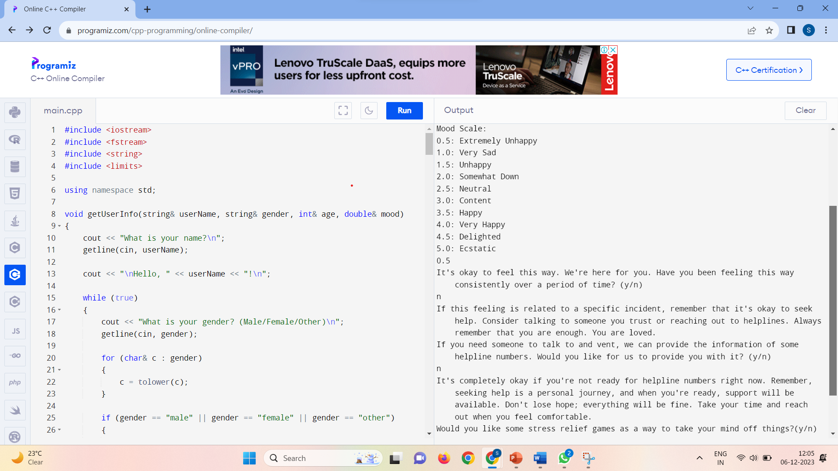
If user does not want helpline numbers information(for non-consistent bad mood):

Slide 36
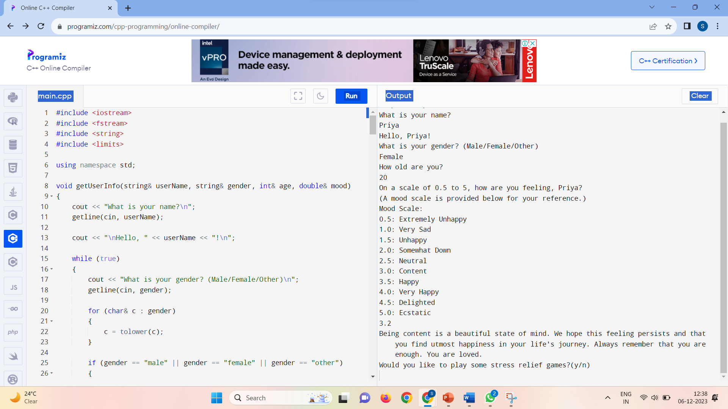
If mood >= 3.0 and mood < 3.5:

Slide 37
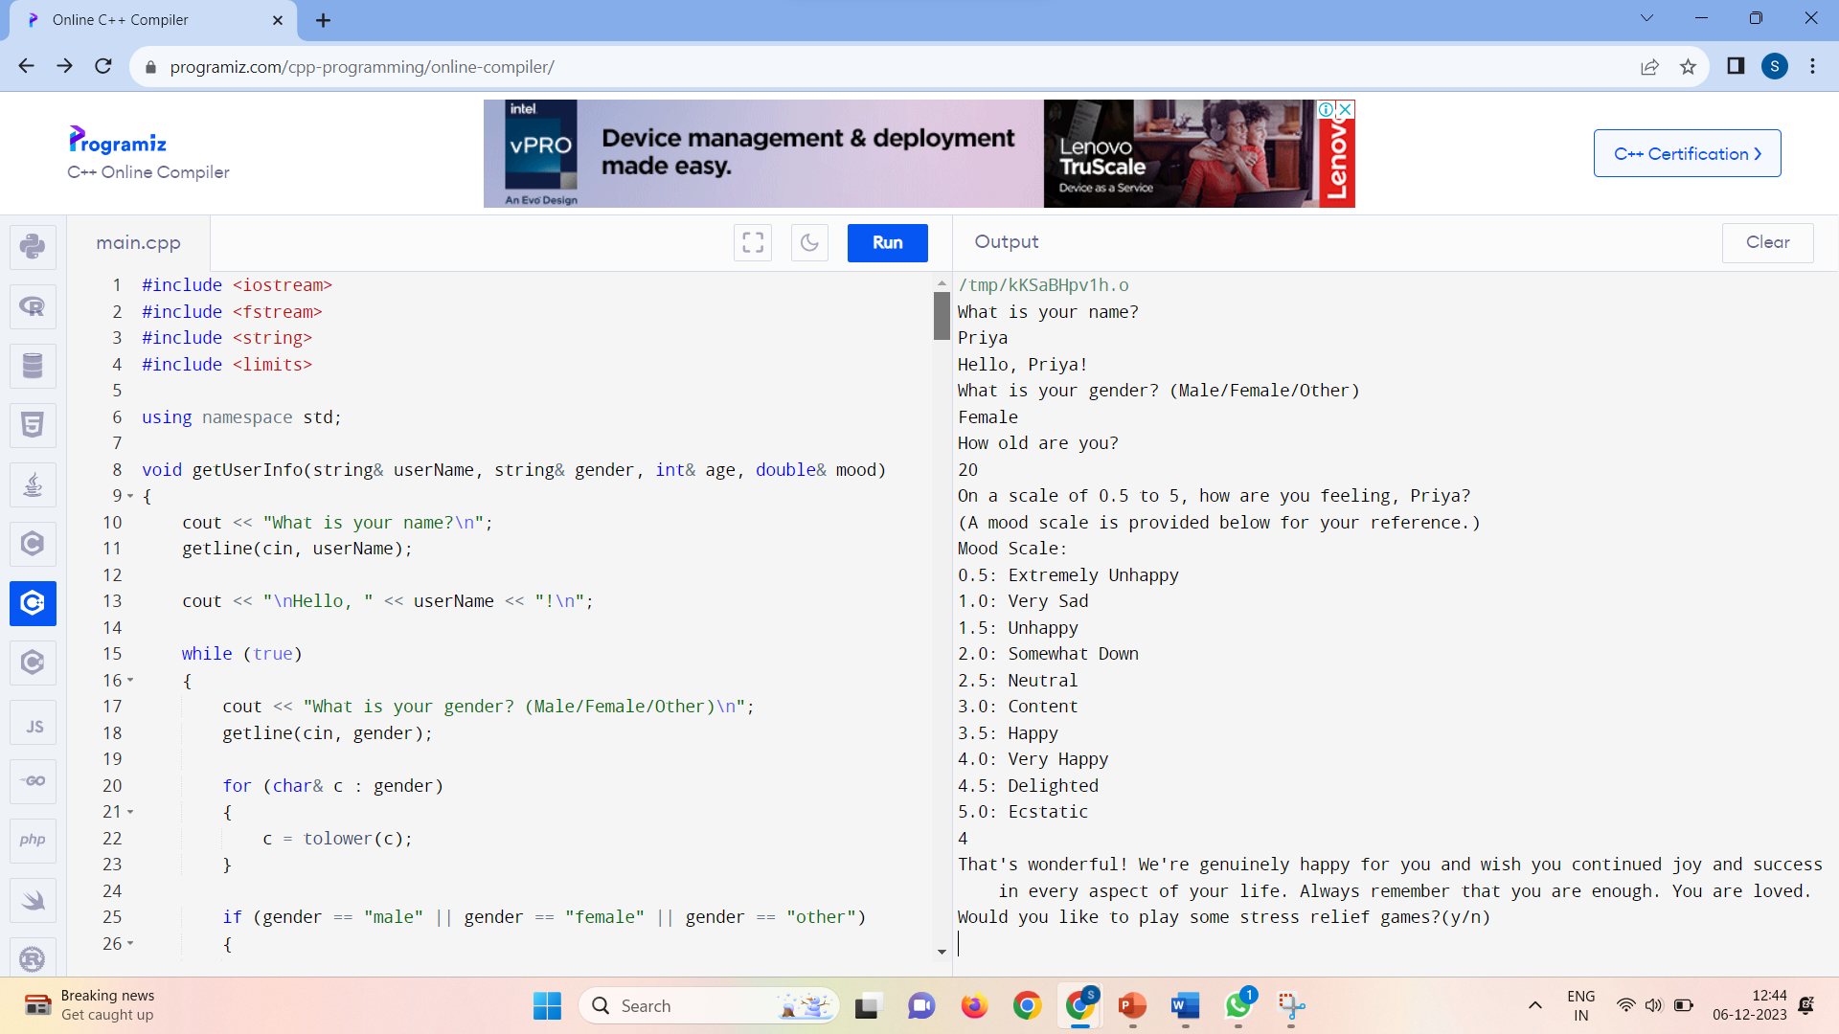
If mood >= 3.5 and mood <= 5.0:

Slide 38
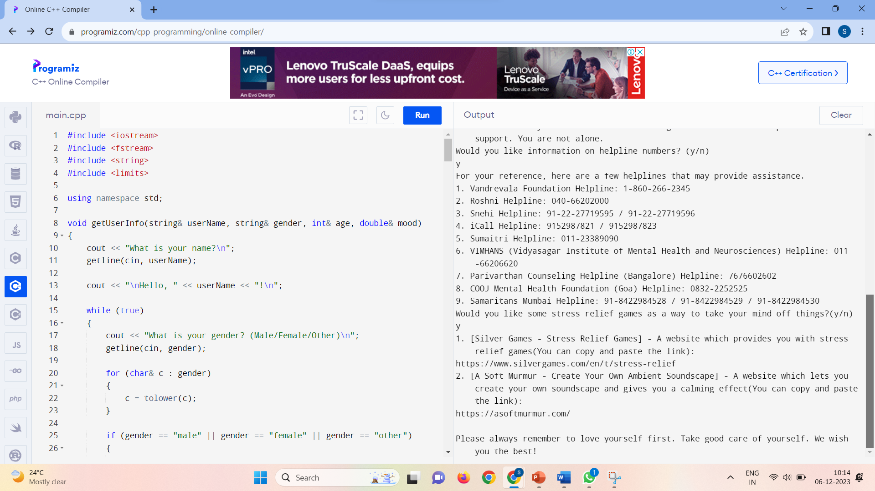
If user wants stress relief games:

Slide 39
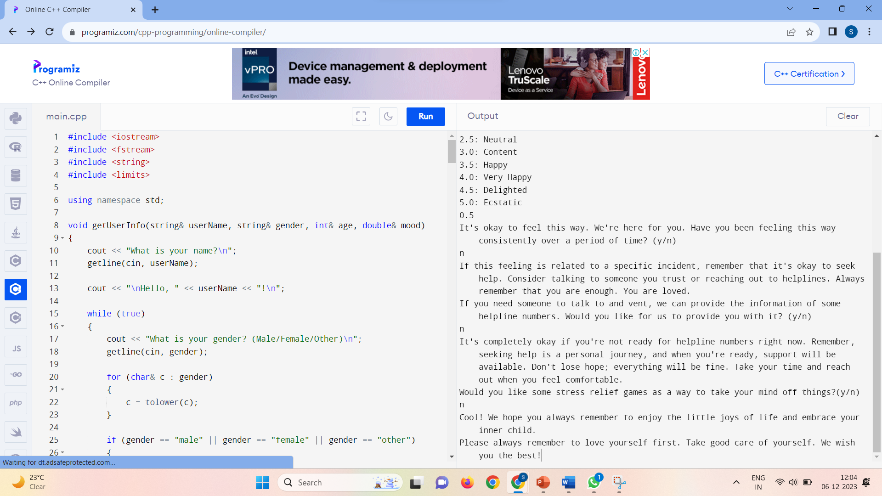
If user does not want stress relief games:

Slide 40
CONCLUSION
This C++ program for mental health and well-being serves as a valuable tool by providing personalized support based on user interactions. Its user-centric design encourages open communication and fosters a positive environment, providing a safe space for individuals to express their feelings, while the inclusion of personalized responses and mood-based suggestions adds a human touch. The program's commitment to data recording ensures continuity in support and potential future improvements. The inclusion of mood assessment, resource provision, and affirmations contributes to a holistic approach, promoting mental health awareness and self-care. By offering additional resources such as helpline numbers and stress relief game suggestions, it goes beyond mere interaction, providing practical tools for coping and seeking help. The program's digital nature ensures accessibility, making it a practical tool for a wide audience seeking support and information. Overall, this initiative is instrumental in addressing mental health challenges, offering a blend of empathy, guidance, and practical resources.

Slide 41
SUBMITTED BY:
AP22110010928 – JYOTHI SAMHITHA KATRAGADDA AP22110010936 – PARDHIV THALLAMSETTI AP22110010981 – NAVYA SREE PINNAMANENI AP22110011520 – PRIYANKA KUMARI SHAH
THANK YOU

